Slide 1
Express yourself, we Must Be Fluent
Monthly Title One Meeting
12/13/2022
Notes:
Are your classroom colors different than what you see in this template? That’s OK! Click on Design -> Variants (the down arrow) -> Pick the color scheme that works for you!
Feel free to change any “You will…” and “I will…” statements to ensure they align with your classroom procedures and rules!

Slide 2

Agenda
“Express Yourself, We Must Be Fluent”
Welcome DeShonna Robinson, PLC Coach Title One Purpose of Express Yourself, We Must Be Fluent Jefferson, Literacy Laurette
Inspirational Moment Video Kid President
3-5th Writing Assessment Faulkner. ILT ELA Lead
Math Fluency Guy, Fifth Grade Math
Are We Ready for TnReady
Upcoming Community Engagement Mr. McPherson

Slide 3

Welcome
We care about our Whitney Scholars
We are committed to Academic Achievement
We only want the best from your child.
We are dedicated to our students.
We strive for Nothing but the best!!!!!
We welcome you with open arms.

Slide 4

Motivation

Slide 5

Purpose
MS Jefferson our Literacy Laurette will discuss the purpose of her position and the purpose of the meeting.
This Photo by Unknown Author is licensed under CC BY-NC

Slide 6
Foundational Skills
By Spring 2023, WES will increase student readiness by 5 points for 3GC in grades K-2

Slide 7

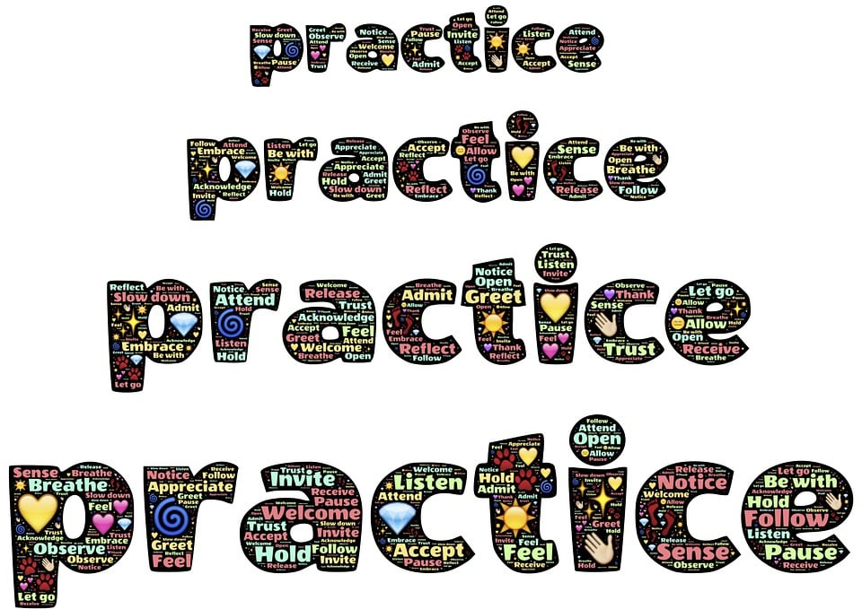
Express yourself

Slide 8
Data
By Spring 2023, WES will increase student performance OTM from 10.8 %(SY22) to 15.8 %(SY23) in reading/ Language Arts.

Slide 9

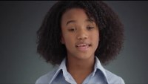
We Must Be Fluent

Slide 10
Data
By Spring 2023, WES will increase OTM from 3.9 %(SY22) to 10.0%(SY23) in grades 3-5 with Math.

Slide 11
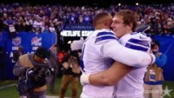
Are You Ready For Tn Ready?
Testing window is April 17- May 2, 2023

Slide 12
Any questions and Concerns
Please feel free to contact
DeShonna Robinson, PLC coach
By email robinsondy@scsk12.org
Any ideas and suggestions to help us improve what we do! Share with us We value your opinion.
Like us on Facebook

Slide 13
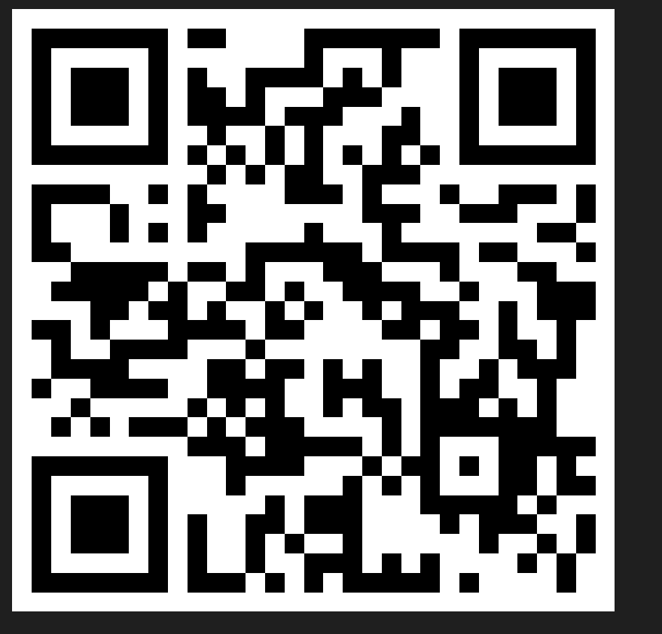
Sign In and Survey
https://forms.office.com/r/AHTpScR90Q

